Slide 1
Supply chain management
Kaidi Wang
kdwang@must.edu.mo
Office: O913
Office hour: 14:00 – 15:00 on Mon., Tue., Wed., Thu.

Slide 2
About me
Name: Kaidi Wang
Education:
Ph.D. in Planning, Governance, and Globalization, Virginia Tech
M.S. in Information Security, Beijing University of Posts and Telecommunications
B.S. in Information Security, Xidian University
Keywords: emerging mobility, transportation planning, simulation, machine learning, GIS
Interests: tennis, cooking, craft

Slide 3
How about you?
Name
Major
Something interesting about you?
What would you like to learn from the course?
Are you interested in any research topic?

Slide 4
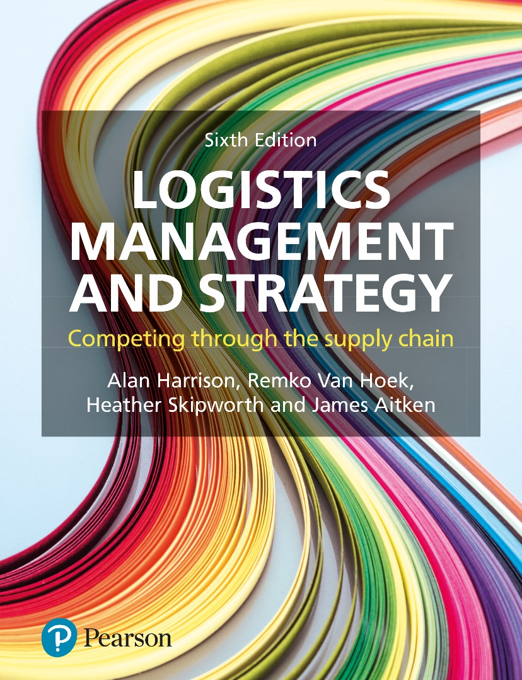
About the course
Course content
Logistics and the supply chain
Putting the end-customer first
Value and logistics costs
Managing logistics internationally
Managing the lead-time frontier
Supply chain planning and control
Lean thinking and agile supply chains
Integrating the supply chain
Sourcing and procurement
Challenges and opportunities
Grading
Attendance (10%)
Participation or discussion (10%)
Assignment (30%)
Examination (50%)

Slide 5
Course policy
Attendance
You can be excused for one missed class without approval
Assignment submission:
1. Submissions later than 24 hours after the deadline are not accepted.
2. Each late submission within 12 hours after the deadline is penalized by 20 points.
3. Each late submission within 24 hours after the deadline is penalized by 50 points.
4. One late submission within 24 hours after the deadline is excused per student without penalty.

Slide 6
Ch01 Logistics and the supply chain
Kaidi Wang
kdwang@must.edu.mo
Office: O913
Office hour: 14:00 – 15:00 on Mon., Tue., Wed., Thu.

Slide 7
Issues
Logistics and the supply chain: definitions, structure, tiering.
Material flow and information flow: the supply chain and the demand chain.
Competing through logistics: competitive criteria in the marketplace.
Logistics strategies: aligning capabilities across the supply chain.

Slide 8
Tesco PLC
The largest food retailer in UK
Between 2010 to 2013, the number of stores in the UK rose from 2300 to 3146.
Since 2013, the rate of increase in the number of stores has slowed.
Tesco UK operates an online store, where the full range of the products are available.
The online stores offer delivery and pickup service.

Slide 9
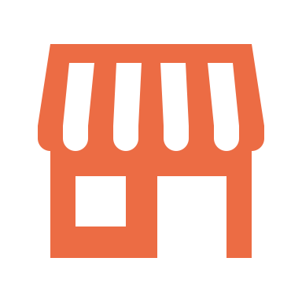



Tesco PLC (cont.)
Pick up items from public stores

Slide 10
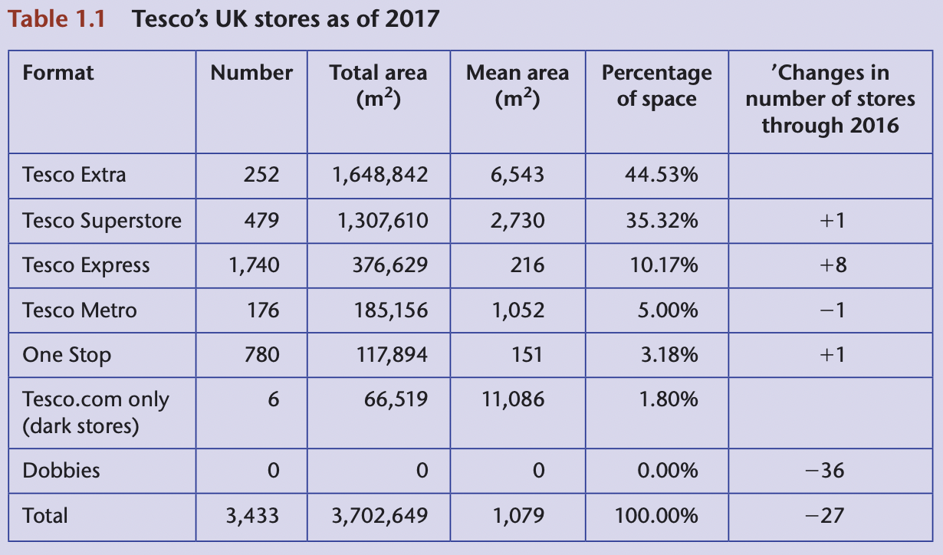
Tesco PLC (cont.)

Slide 11
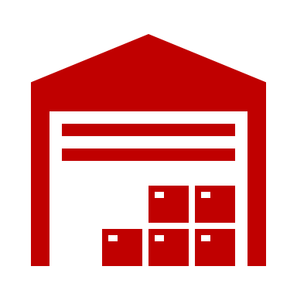
Tesco PLC (cont.)
Pick up items from dark stores

Slide 12
Tesco PLC (cont.)
The layout of dark stores are similar to conventional supermarkets.
Online orders are process and used to optimize the picking routes.
Personal shoppers pick online orders 24 hours, 7 days a week. They normally process multiple orders at the same time.

Slide 13
Tesco – economies of scale
Expanded range of product
Larger sales and better quality
More suppliers
Any challenges?

Slide 14
Tesco PLC – initial improvement
Small depots
Any challenges?
They cannot process large volume.
There is not temperature control

Slide 15
Tesco PLC – initial improvement
Small depots
Any challenges?
They cannot process large volume.
There is not temperature control

Slide 16
Tesco PLC – further improvement
Martial flow from suppliers to stores

Slide 17
Tesco PLC – further improvement (cont.)
They use electronic point of sale (EPOS) system to track the sales of each product.
Tesco information exchange (TIE) are used to update cumulative sales by store.
During 1990's, Tesco ordered only what is required to meet next day's need, thereby reducing the stock in their depots.

Slide 18
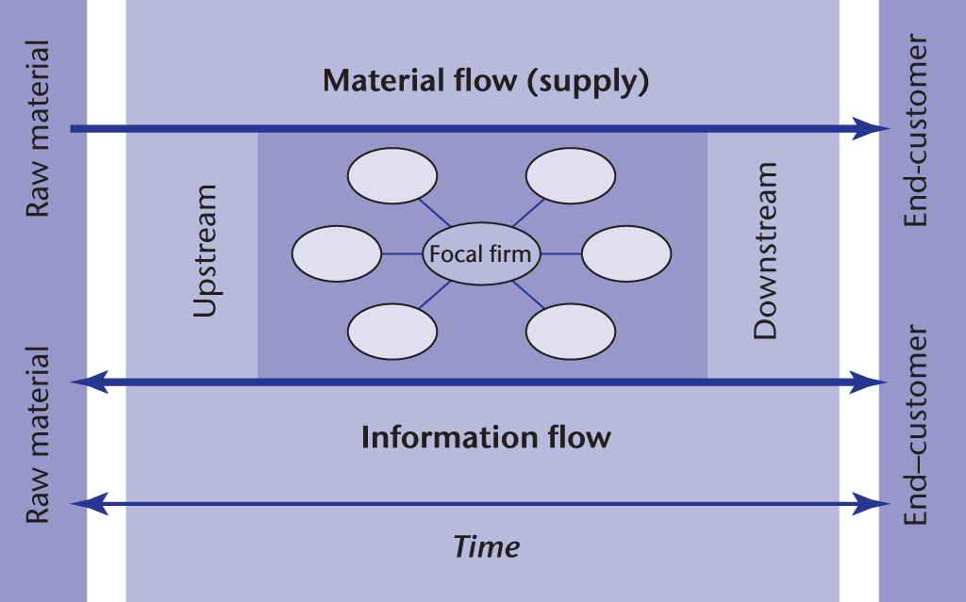
Competing through logistics

Slide 19

Challenges to Tesco
Understanding customers’ need.
The products need to worth the value for money
Ensuring the products needed by customers are available on the shelf of stores and online, at all times, day and night.

Slide 20
Define logistics
Logistics is the task of planning and controlling the purchase and distribution of Tesco’s massive product range from suppliers to stores. It concerned with managing the two key flows.
material flow of the physical goods from suppliers through the distribution centres to stores and for the online business through to the end-customer;
information flow of demand data from the end-customer back to purchasing and to suppliers, and supply data from suppliers to the retailer, so that material flow can be planned and controlled accurately.

Slide 21
Define supply chain management
Supply chain management is concerned with managing the entire chain of processes, including raw material supply, manufacture, packaging and distribution to the end-customer.
A supply chain as a whole ranges from basic commodities (what is in the ground, sea or air) to selling the final product to the end-customer, to recycling the used product.
The analogy to the flow of water in a river is often used to describe organizations near the source as `upstream`, and those near the end-customer as `downstream`.

Slide 22
Define supply chain management
A supply chain is a network of partners who collectively convert a basic commodity (upstream) into a finished product (downstream) that is valued by end-customers, and who manage returns at each stage.
Planning: making a plan that defines how much of each product should be bought, made, distributed and sold each day, week or month.
Controlling: keeping to plan in spite of the many problems that may get in the way.

Slide 23
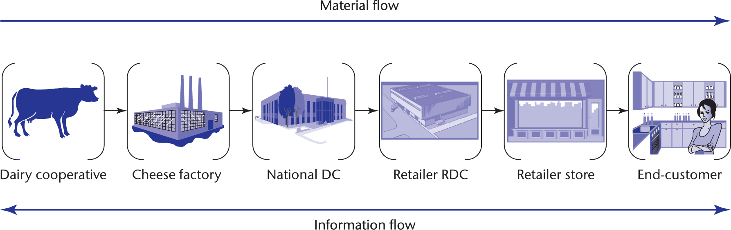
From cow to customers

Slide 24
Two concerns after products are sold
Reverse logistics: the return of unwanted goods and packaging in the opposite direction (from right to left) to the normal flow.
Waste: the discarding of product at any stage in the supply chain due to quality problems.

Slide 25
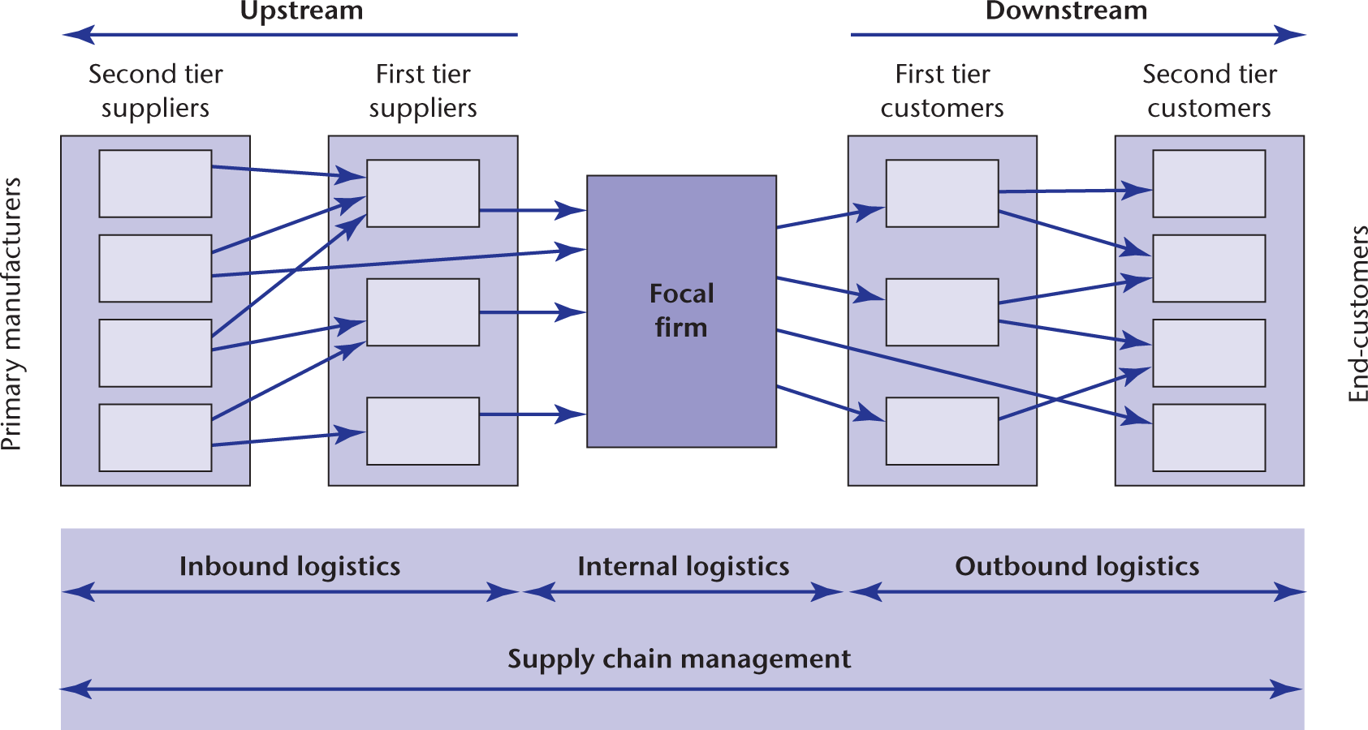
Supply chain network
Notes:
If everything is as orderly as it seems, then only the end-customer (to the extreme right of the chain) is free to place orders when he or she likes: after that, the system takes over.

Slide 26
Supply chain management
The ultimate aim of supply chain management is to integrate inbound, outbound and internal logistics into a seamless whole, focused on meeting end-customer needs with no waste.
Purchasing and supply: deals with a firm’s immediate suppliers (upstream)
Physical distribution: the task of distributing products to tier 1 customers (downstream)
Logistics: management of material and information flows.
Inbound logistics: deals with links between the focal firms and its upstream suppliers
Outbound logistics: refers to the links between the focal firms and its downstream customers
Internal logistics: deals with planning and control of material flow within the boundary of the focal firm.

Slide 27

Flow
Time is important because it measures the speed with which a given network can respond to demand from the end-customer. In fact, the concept of flow is based on time.
Flow measures the quantity of material (measured in input terms such as numbers of components, tones or litres) that passes through a given network per unit of time.

Slide 28
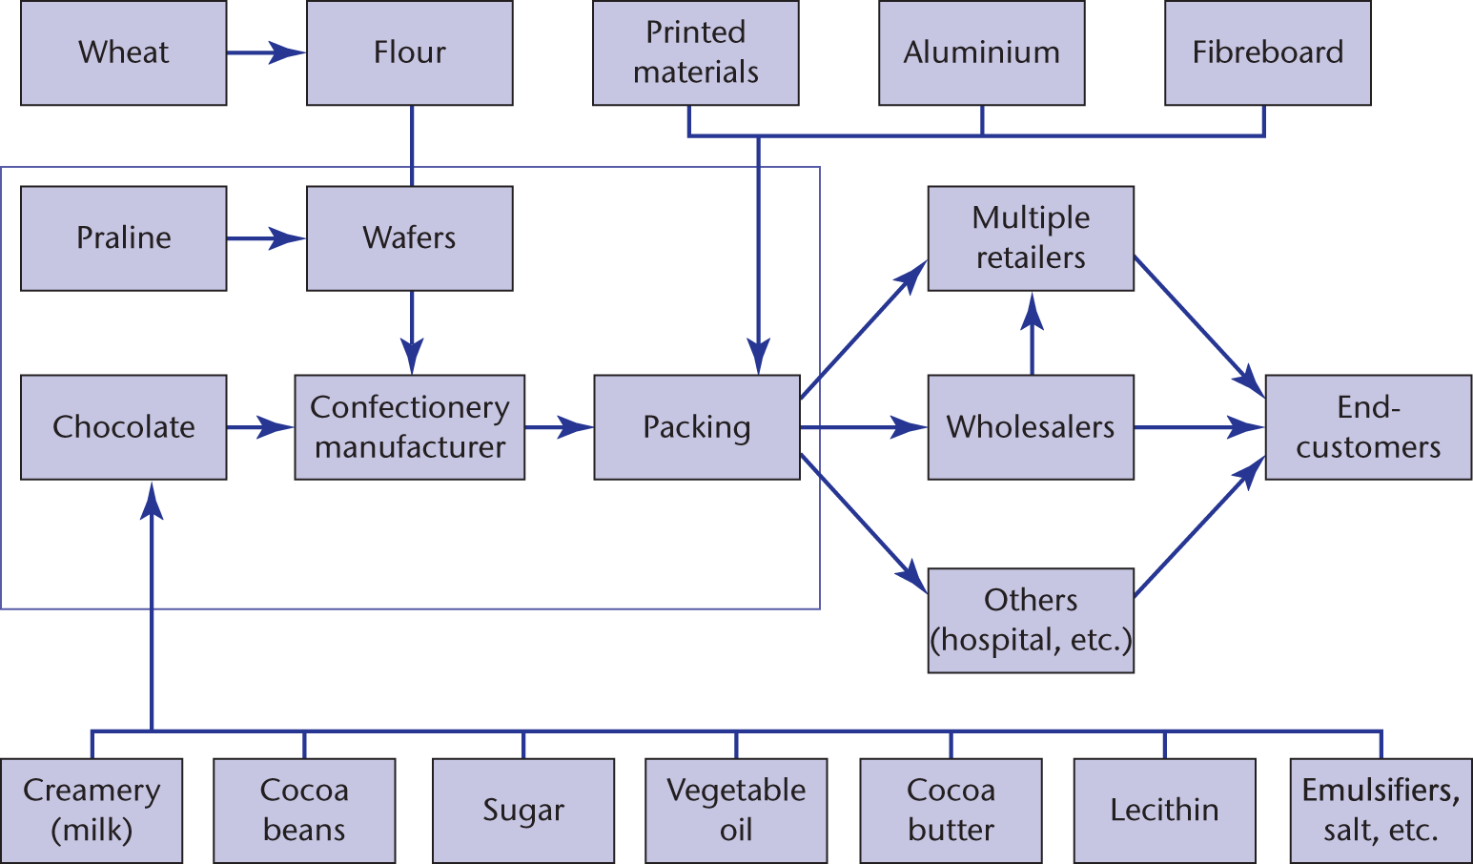
Confectionery network
Upstream
Downstream
Internal process
Material flow
1st and 2nd tier suppliers and customers

Slide 29
Material flow
The goal is continuous, synchronous flow.
Continuous means no interruptions, no dropping the ball, no unnecessary accumulations of inventory.
And synchronous means that it all runs like a ballet. Parts and components are delivered on time, in the proper sequence, exactly to the point they’re needed.
Greedy members of a supply chain are weak partners, since they often end up holding the inventories.

Slide 30
Xerox
An US company that makes photocopiers.
They are faced with the ‘feast or famine’ situation.
Objective for next move: make only what you need when you need it, then shipping to the customers.
Introduction: just-in-time production systems.

Slide 31
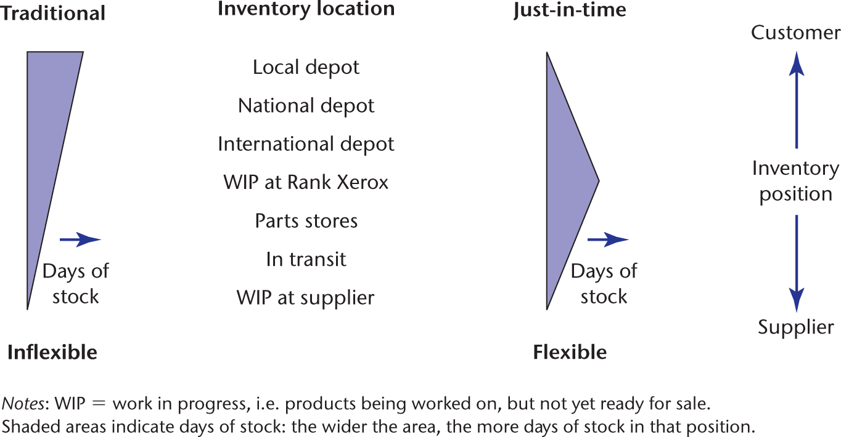
Xerox - Inventory profile
Explain the case?
Inventory is held further upstream.

Slide 32
Xerox – Just in time (JIT)
Deliver JIT
products are delivered out of stock. - commodity
Finish JIT
build semi-finished products with the minimum of added value. – mid-range product
Build JIT
build large products within a defined lead time. – larger products

Slide 33
Question
How does such a supply chain structure improve the competitiveness at Xerox?

Slide 34
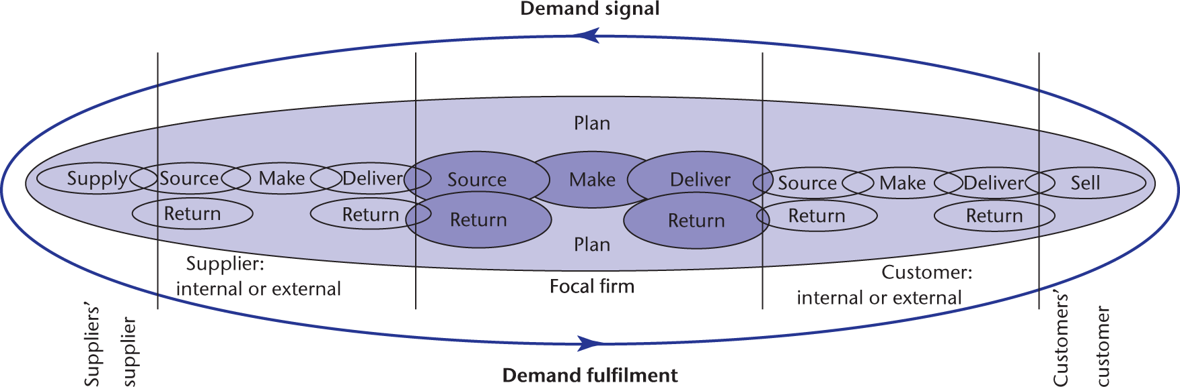
Integrating demand and supply chains

Slide 35
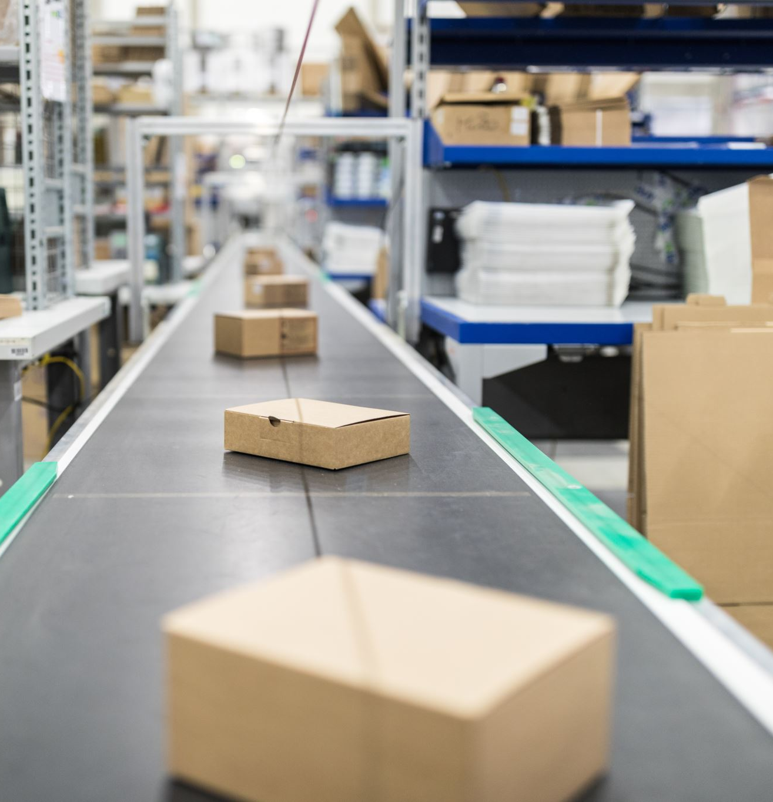
Competing through logistics
Products = physical product + service
Service is heavily influenced by logistics
What are the competitive priorities should logistics in the supply chain provide?
meeting end-customer demand through supplying what is needed in the form it is needed, when it is needed, at a competitive cost.
Hard objectives: quality, time, cost
Supportive capabilities:
Controlling variability
Dealing with uncertainty
Sustainability
Soft objective: relates to service aspects, e.g., customer confidence

Slide 36
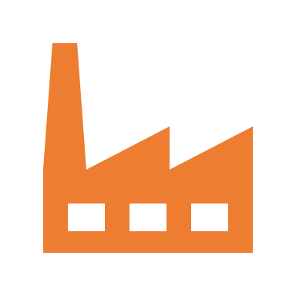

Hard objectives
Quality: defects, incorrect quantities and wrong items delivered are symptoms of quality problems in supply chain processes.
Supply chain
End customers see the worst status of the products.
25 per million
Crush cases when wrapped; sharp knife cut open cases, etc.
10,000 to 20,000 per million

Slide 37

Quality of service
Sometimes, it is concerned with selecting the right quantity of the right product in the right sequence.
Picking accuracy: correct item, correct quantity against tight delivery schedule.

Slide 38
The time advantage
Time measures how long a customer has to wait in order to receive a given product or service.
Time can be used to win orders by companies who have learnt that some customers do not want to wait – and are prepared to pay a premium to get what they want quickly.

Slide 39
Vision Express
Offers prescription spectacles in about one hour.
Staff are given incentives to maintain a 95 per cent service level against the one-hour target.
Other opticians send customer orders to a central factory, where it takes 10 days to produce the spectacles. Then the factory send the spectacles to the store.

Slide 40
The time advantage
The time advantage is described variously as speed or responsiveness in practice.
Other benefits:
Reduce the risk of obsolete or over-aged stock
Improve the freshness of the end product.

Slide 41
The cost advantage
Examples:
Own-brand supermarket: reduce the cost of advertising and cut cost from product specification
Automotive component suppliers and assemblers: set annual price reduction target for the inbound supply chains; Toyota announced demands for a 30 per cent reduction in prices on many components by the time that new models were launched in 2013.
Reduced cost is a collaborative effect by several partners in the supply chain. So, Toyota uses more common parts to help achieve the goal.

Slide 42
Competing through logistics
Products = physical product + service
Service is heavily influenced by logistics
What are the competitive priorities should logistics in the supply chain provide?
meeting end-customer demand through supplying what is needed in the form it is needed, when it is needed, at a competitive cost.
Hard objectives: quality, time, cost
Supportive capabilities:
Controlling variability
Dealing with uncertainty
Sustainability
Soft objective: relates to service aspects, e.g., customer confidence

Slide 43
Supportive capabilities
Variability refers to real and identifiable differences within a population, such as the differences in time each patient at an optician has to wait for his or her eyes to be tested.
Uncertainty refers to our lack of knowledge: in logistics terms, uncertainty results in us having to deal with changes that are either not known in advance or cannot be forecast with accuracy.
Sustainability addresses the improvement of environ-mental, social and economic values in the design of logistics systems.

Slide 44
Controlling variability: the dependability advantage
Delivery dependability measures how successful the firm has been in meeting those promises such as one hour delivery.
UK’s Royal Mail quality of service target:
first-class: 93% arrive the next working day
They missed the target in 2018 due to challenging industrial relations environment, severe weather, reduced staffing levels due to flu outbreak.
It is important to measure dependability in the same ‘end to end’ way that speed is measured.

Slide 45
Measuring dependability
In manufacturing firms, dependability is used to monitor a supplier’s performance in such terms as:
on time (percentage of orders delivered on time and the variability against target);
in full (percentage of orders delivered complete and the variability against target);
on quality (percentage of defects and the variability against target).
So, logistics is concerned not just with the average percentage of orders delivered on time but also with the variability

Slide 46
Measuring schedule variability
A vehicle assembler issues delivery schedules to specify how many parts of each type are required each day for the following month.
And each day a ‘call-off’ quantity is issued, which specifies how many the vehicle assembler actually wants.
The total scheduled quantities and the total call-off quantities are the same but what is the problem?
The problem is that the supplier has to cope with the variability of call-off quantities that create huge problems for the supplier’s process.

Slide 47
Measuring schedule variability
S = Scheduled demand
A = Actual call-off quantity
The difference between schedule and actual is given by D = S – A
Two scenarios:
S > A, so the supplier will over-produce the part and end up with excess stock; or
S < A, so there is a shortfall (S - A) of parts from the supplier, unless the supplier holds a stock of the parts, in which case it is an opportunity to reduce them.

Slide 48
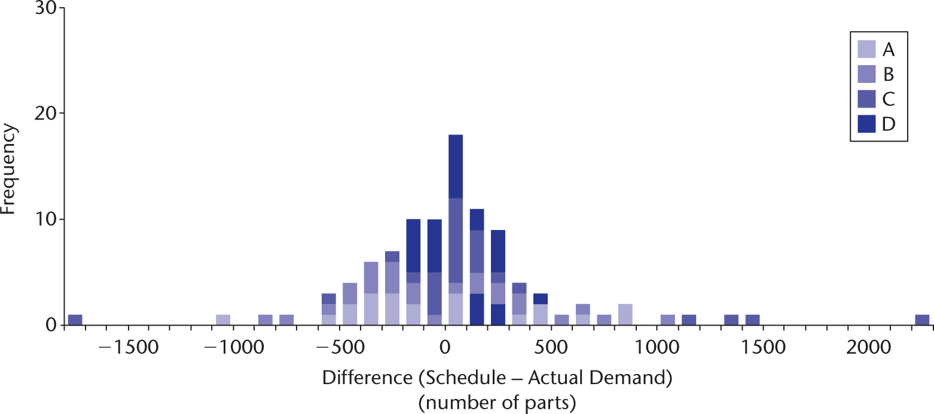
Measuring schedule variability - WestCo

Slide 49
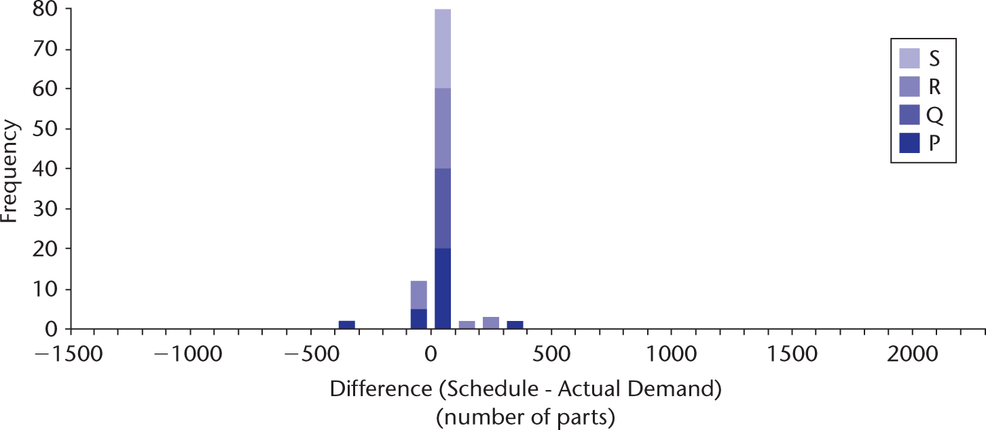
Measuring schedule variability - EastCo

Slide 50
Questions
What are the logistics implications for PressCo to ensure high delivery reliability to customers WestCo and EastCo?
The supplier should hold much higher inventories for WestCo. Stock levels for EastCo can be managed using the stable schedule
What steps will the supplier need to take in order to satisfy call-off orders from WestCo?
Set up a separate stock room for WestCo and separate the production facilities for WestCo and EastCo. Otherwise, the inefficiency of supplying WestCo will hobble the streamlined production for EastCo.
If separate parts of the PressCo factory were dedicated to production for WestCo and for EastCo, which would be the more efficient in terms of labour costs and inventory holding?
EastCo

Slide 51
Dealing with uncertainty
P&G’s supply chain keeping babies dry
In 2012 the company realised $84 billion in sales and 25 of its brands generated $1 billion or more revenue.
In order to realise this revenue, the company procures inputs worth over $51 billion from over 75,000 suppliers, operates 140 plants around the world and over 250 shipping locations, and transports products a total distance of over 1.5 billion kilometres per year to reach 4.6 billion consumers daily.
In the last week of September 2012, an explosion at a Japanese chemical plant threatened to cause a global nappy shortage.
The plant makes 20% of the share of the world’s superabsorbent polymers.

Slide 52
Dealing with uncertainty
As an emergency response, a Nippon Shokubai plant in the USA, which previously had been shut down, was restarted with P&G assistance and shipments were rerouted. Adjustments were required to the sup-ply chain plan, including the delay of some new product introductions.
But, in the end, zero shipments to customers were missed and no nappy scarcity was experienced at the retail level, whilst relationships between P&G and Nippon Shokubai improved and strengthened.
What are the key lessons from this case for dealing effectively with disruptions to the supply chain?

Slide 53
Lessons from the P&G’s response
The event is unanticipated but the consequence is catastrophic. Therefore, we should establish the contingency plans for unanticipated yet critical supply disruptions.
Speed of the response is important
Involve suppliers from the outset.
Re-plan the supply chain to be resistant to the disruption.

Slide 54

Flexibility
The implication of uncertainty for supply chain processes is that they need to be flexible to respond to both anticipated and unanticipated changes. Flexibility is defined as the ‘ability to react or transform [supply chain processes] with minimum penalties in time, cost and performance’ (Upton, 1995)
Dynamic flexibility: allows firms to cope with certain shifts in demand and technology, but only within the set structure of their existing supply chain design.
Structural flexibility: builds flexible options into the design of the supply chain, such as dual sourcing, sharing assets, postponement, rapid manufacture, flexible labour arrangements and outsourcing.

Slide 55
The sustainable advantage
Environment
Social
Economics

Slide 56
Plan A at Marker & Spencer
Plan A set out 100 commitments – goals to be achieved by 2012 – covering climate change, raw materials, waste, health and fair partnership. A total of €300 million was set aside to fund the plan over the five years, and 14 staff applied to its delivery.
Noted in particular for its comprehensive approach and willingness to use the company’s influence with customers, suppliers, investors and politicians, the plan has been praised as an example of best practice, win-ning many independent awards.
We’re doing this because it’s what you want us to do. It’s also the right thing to do. We’re calling it Plan A because we believe it’s now the only way to do business.

Slide 57
7 Plan A pillars
Involve our customers in Plan A: e.g. Breakthrough Breast Cancer.
Make Plan A how we do business: e.g. free energy monitors, free home insulation.
Climate change: e.g. carbon labelling and energy-efficient electrical products.
Waste: e.g. recycle, reuse and reduce packaging materials.
Natural resources: e.g. reduced water usage and sustainably farmed fish.
Fair partner: e.g. supplier ethical assessments.
Health and wellbeing: e.g. reduced salt, natural colours and nutritional labelling.

Slide 58
How does Plan A work
So how has M&S made sure Plan A ‘really works’? Feedback tells the company that
customers discern and value the Plan A difference between M&S and other retailers, and this translates into increased foot traffic and a wider customer base.

